Slide 1
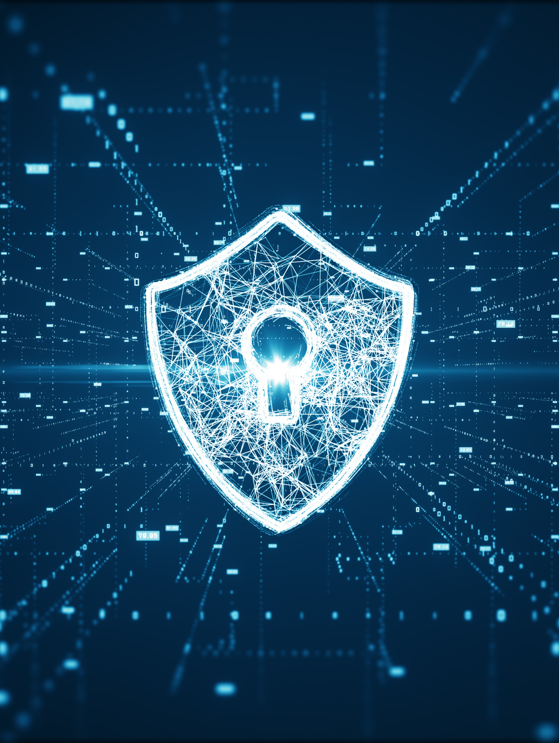

SAVING RYAN’S PRIVATES
Addressing the complex security problems around leaky nudes
Johnny Xmas, CISSP, GIAC
Technical Director of Training, GRIMM

Slide 2

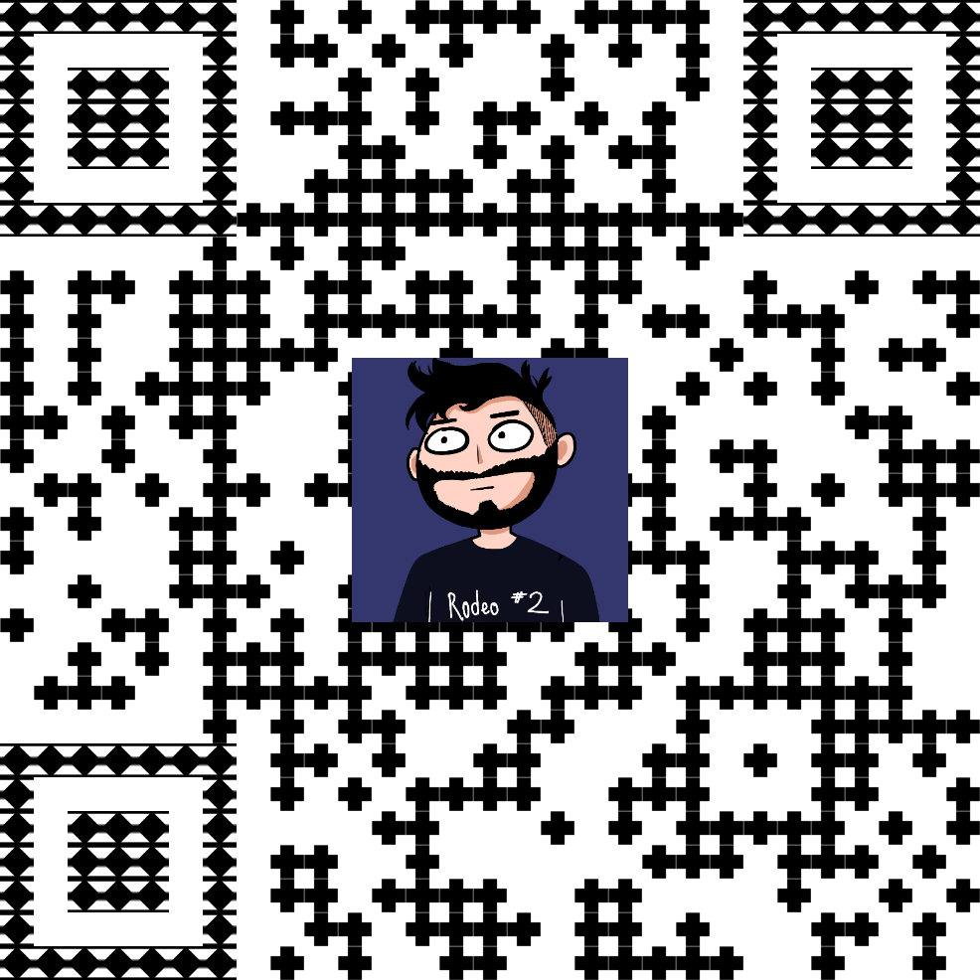


Requisite Slide of
Stuff you don’t Care About
Music Major
Urban Explorer
Troublemaker
Educator
Community Leader
HACKER
https://linktr.ee/johnnyxmas

Slide 3

STATS!

Slide 4

STATS!
I was gonna try to Google some stats,
so you can just go do that.
It’s impossible to accurately
track this, anyway.
WE ALL KNOW THIS IS
A HUGE PROBLEM, REGARDLESS

Slide 5
QUIZ REVIEW!

Slide 6

UNIQUE PASSWORDS
Billions of credentials are leaked/shared every year from hacked systems
Vendors rarely directly inform their users
Attackers “spray” these credentials at OTHER sites & services

Slide 7
COMPLEX PASSWORDS
Does not help if you reuse passwords
Increase the amount of time necessary for an attacker to guess them

Slide 8
Multi-Factor Auth.
Like having 2 passwords, one of which rotates
Great even when your password sucks
Requires attacker to access the device or service that has your “token”

Slide 9
So How do Leaks Happen, Then?

Slide 10

YOUR PARTNER SUCKS
(In the bad way)
Intentional Leaks
Their cybersecurity posture sucks
They’re using a non-encrypting messaging system
No End-to-End Encryption
No Message Expiration

Slide 11
YOUR PARTNER SUCKS
(In the bad way)
Intentional Leaks
Their cybersecurity posture sucks
They’re using a non-encrypting messaging system
No End-to-End Encryption
No Message Expiration
IT IS IMPOSSIBLE FOR ANY GROUP CHAT TO HAVE E2E ENCRYPTION.

Slide 12
You’re Using
Somebody Else’s Computer
You didn’t know
You do this constantly
It’s required for many (most) scenarios

Slide 13
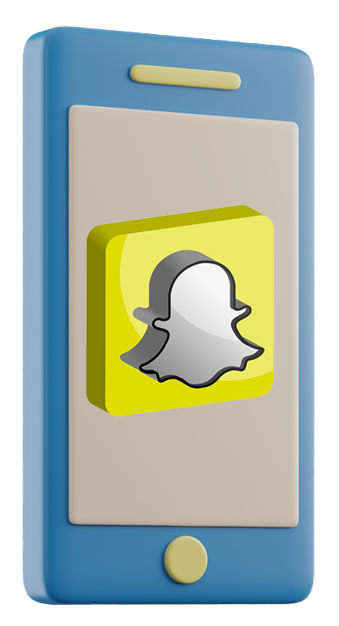

Slide 14


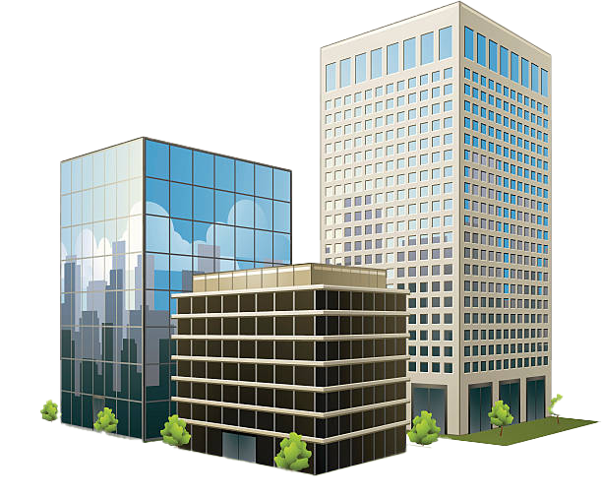

Slide 15
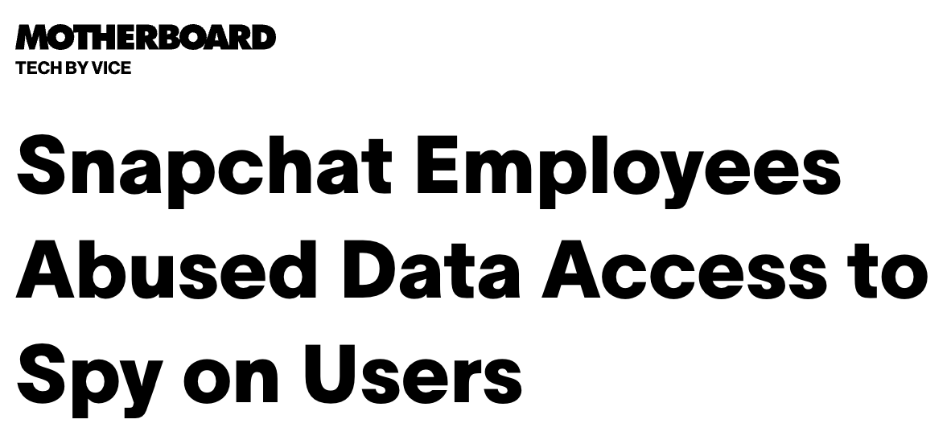
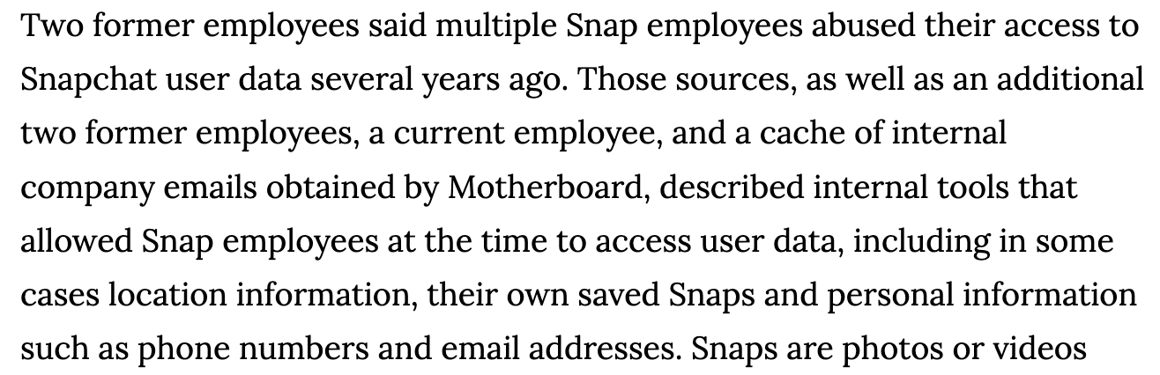
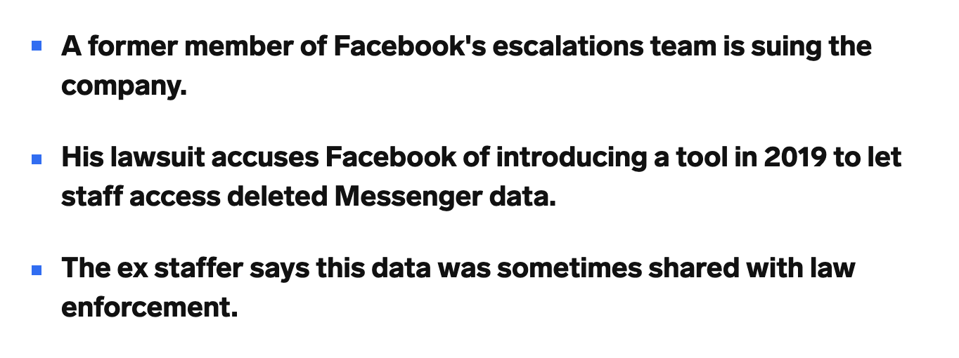
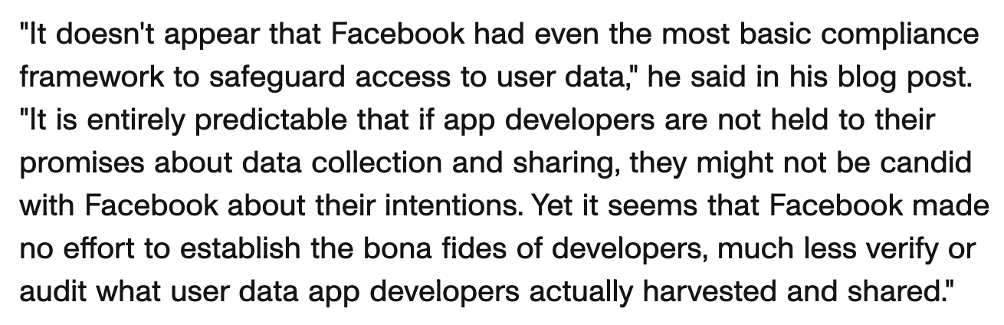

Slide 16
IT IS IMPOSSIBLE FOR ANY GROUP CHAT TO HAVE E2E ENCRYPTION.

Slide 17
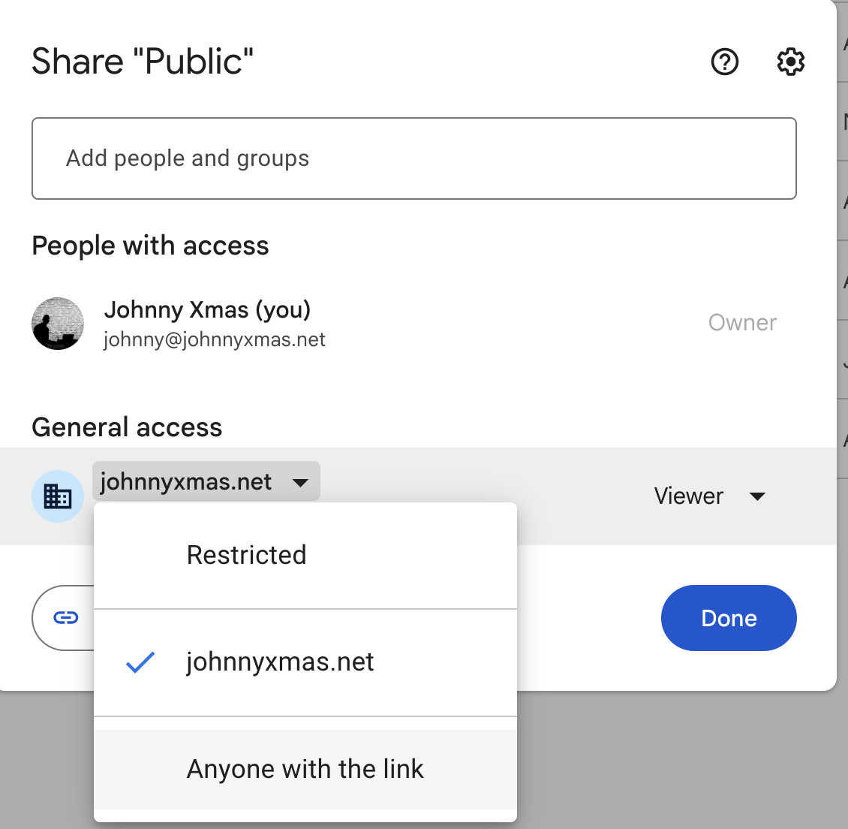
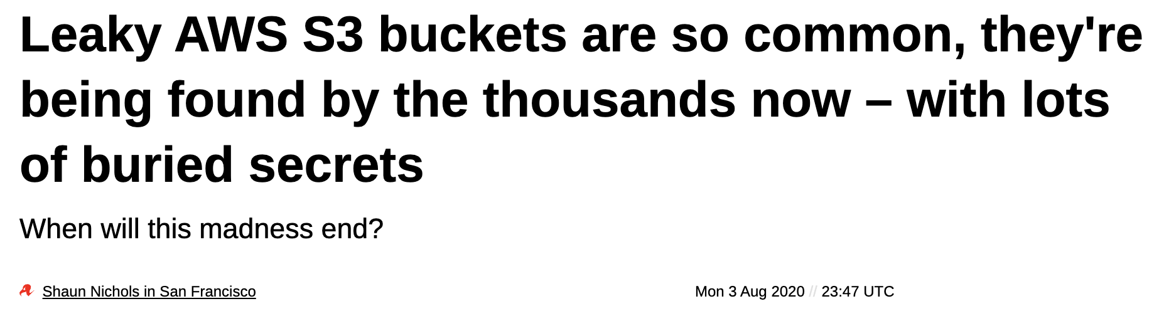
You’re Using
Somebody Else’s Computer
Discord recently fixed this problem…
OnlyFans has it RIGHT NOW.

Slide 18
Also: Actual Hax

Slide 19

INSECURE APIs
Most interactive web “sites” are actually applications (“web apps”)
App uses an “API” pathway and language to send/receive info & assets
Many are way too trusting

Slide 20

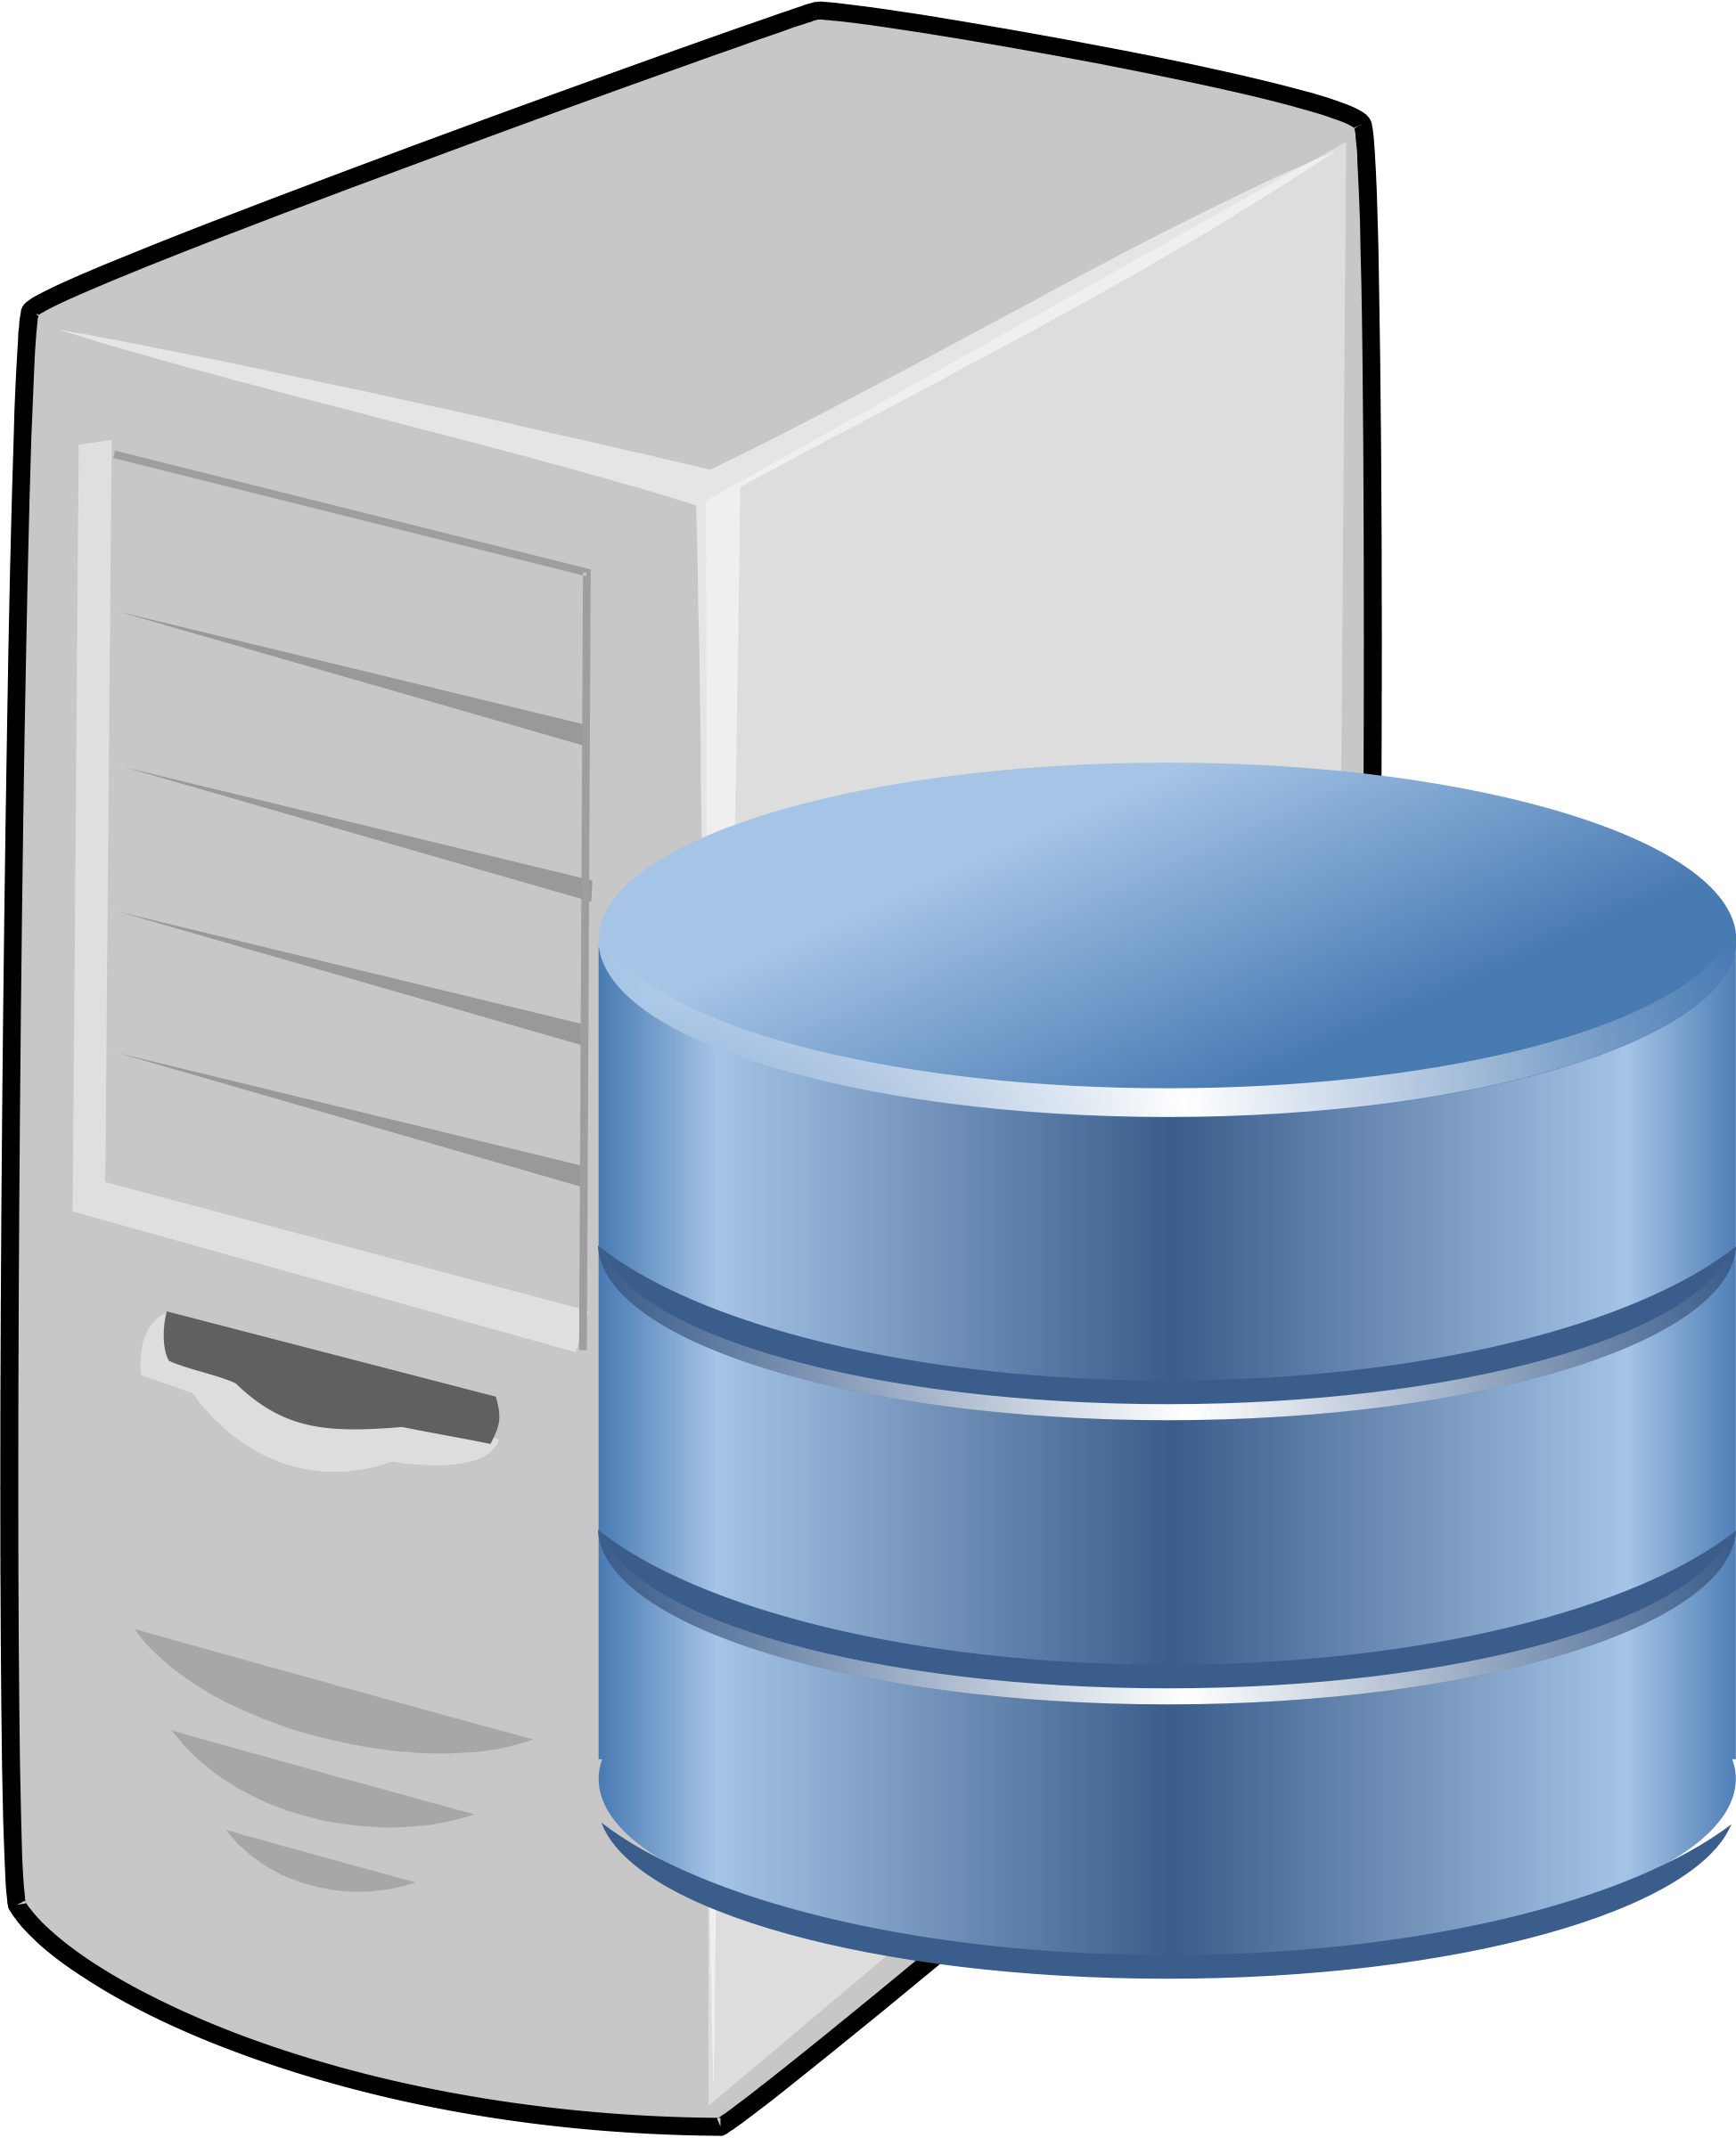
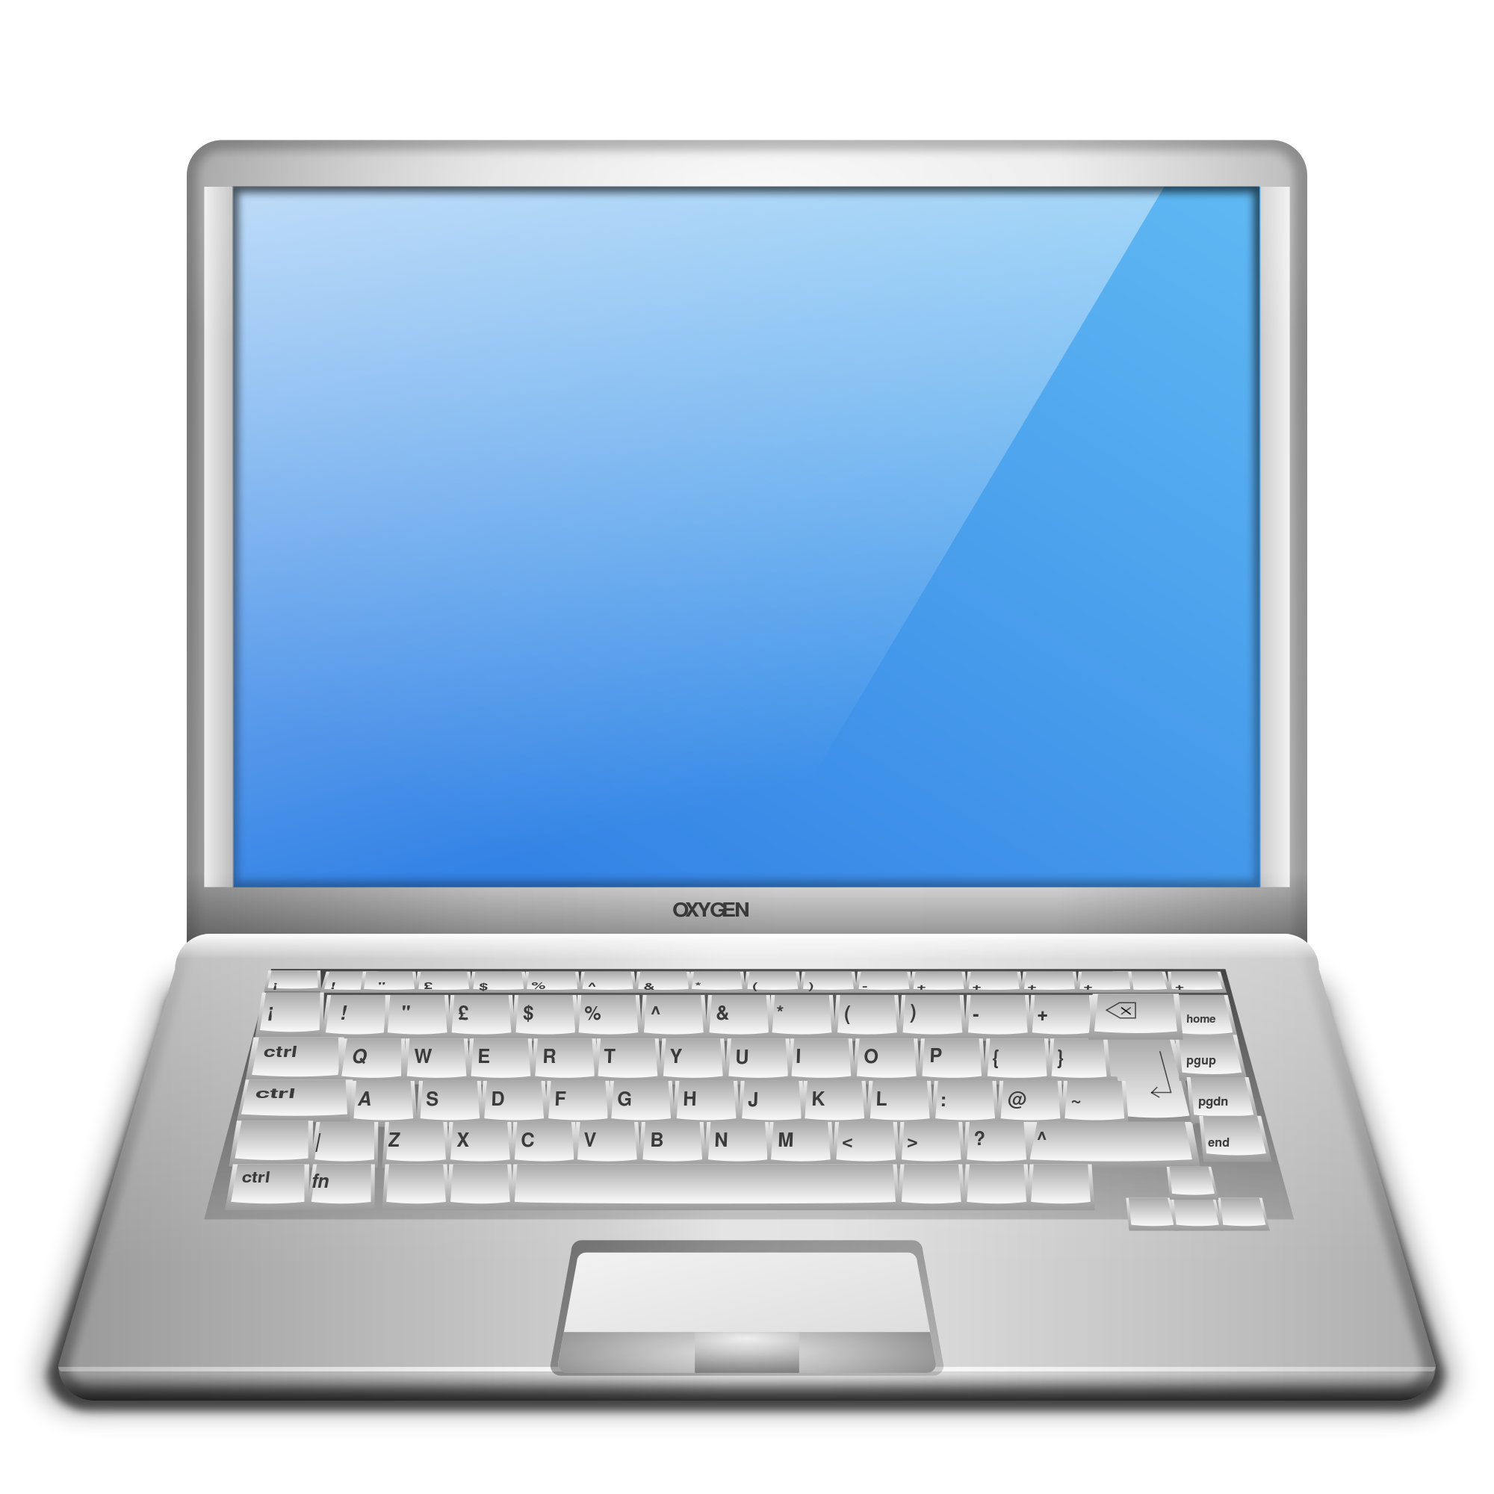
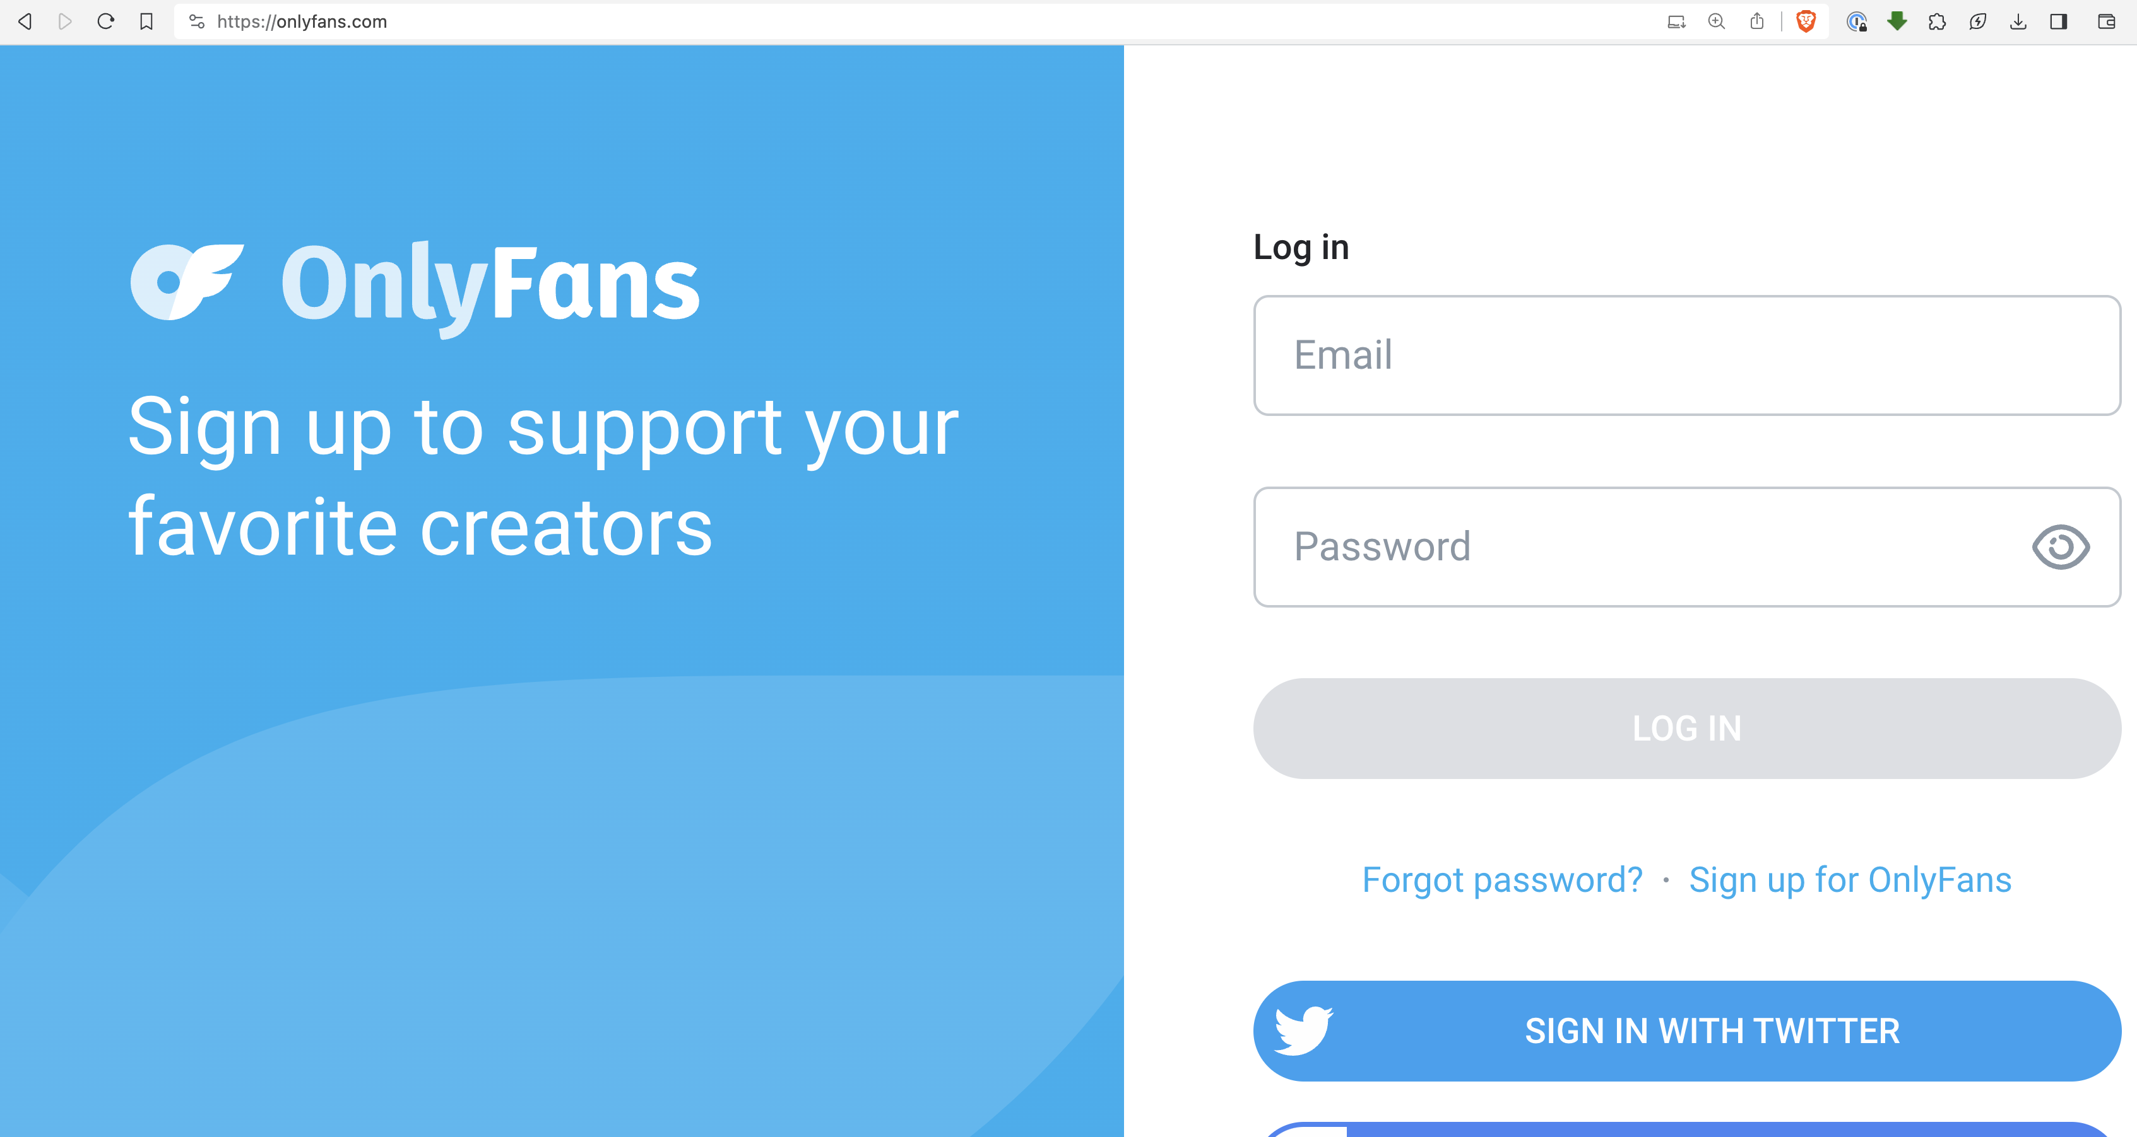


INSECURE APIs
$

Slide 21
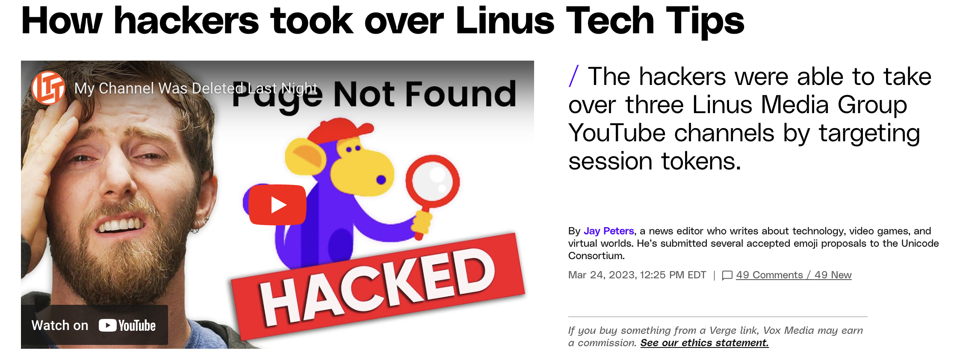
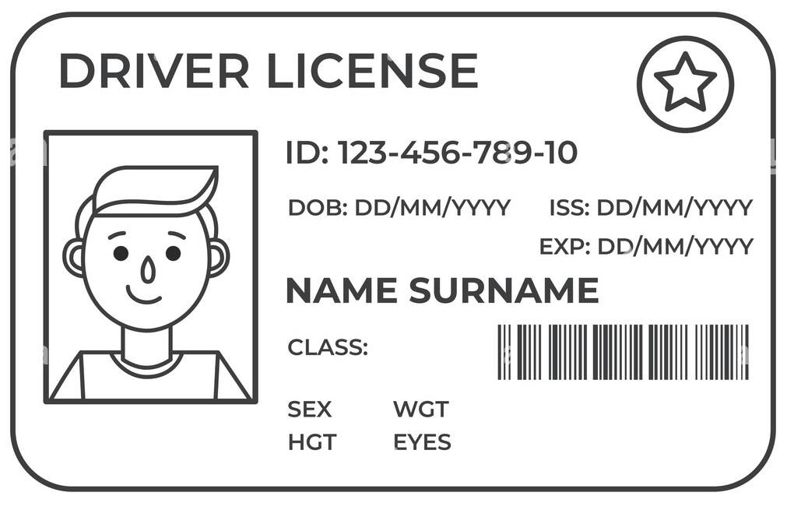


Session Token Theft

Slide 22
Session Token Theft
Stolen via browser or directly from the files in your computer
Most often using malicious links in emails or malicious sites
Sometimes requires no user interaction (“drive-by” attacks)

Slide 23
Other Hacks
RATs (Remote Access Terminal) - Mainly for spying via webcams / security cams but can enable file access
Compromised communication (or other) apps
Encryption doesn’t matter if they grab the message before it’s encrypted

Slide 24
MITIGATING CONTROLS

Slide 25
MITIGATING CONTROLS
Use a *good* password manager
Bank & PW Manager PWs should be long, memorized and never digitally documented
Use extremely long, complex and unique passwords
Enable MFA wherever possible

Slide 26
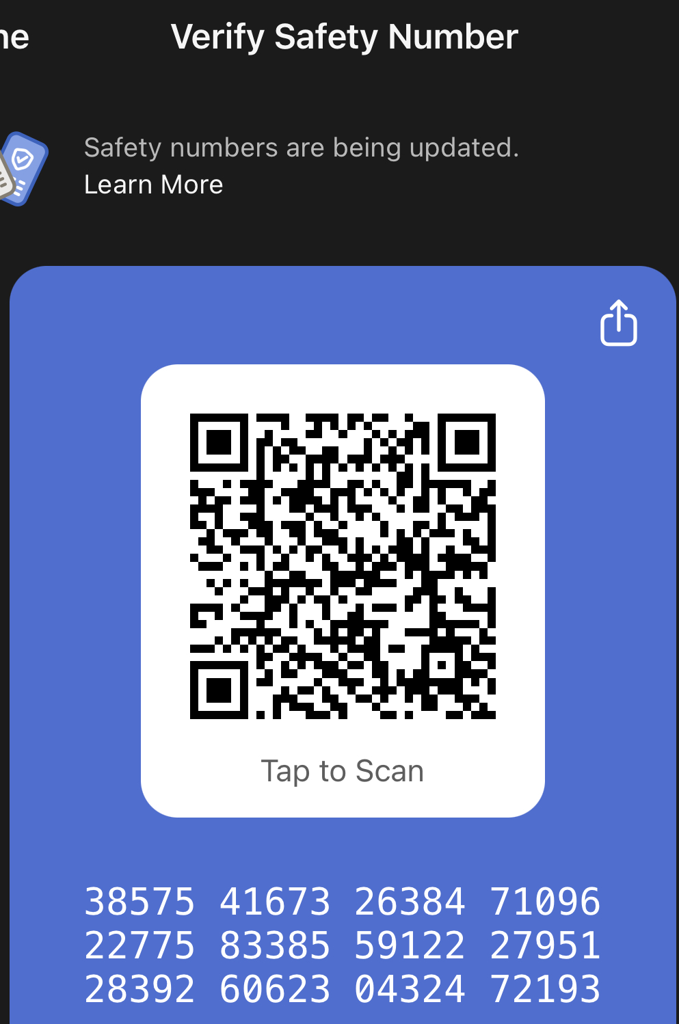
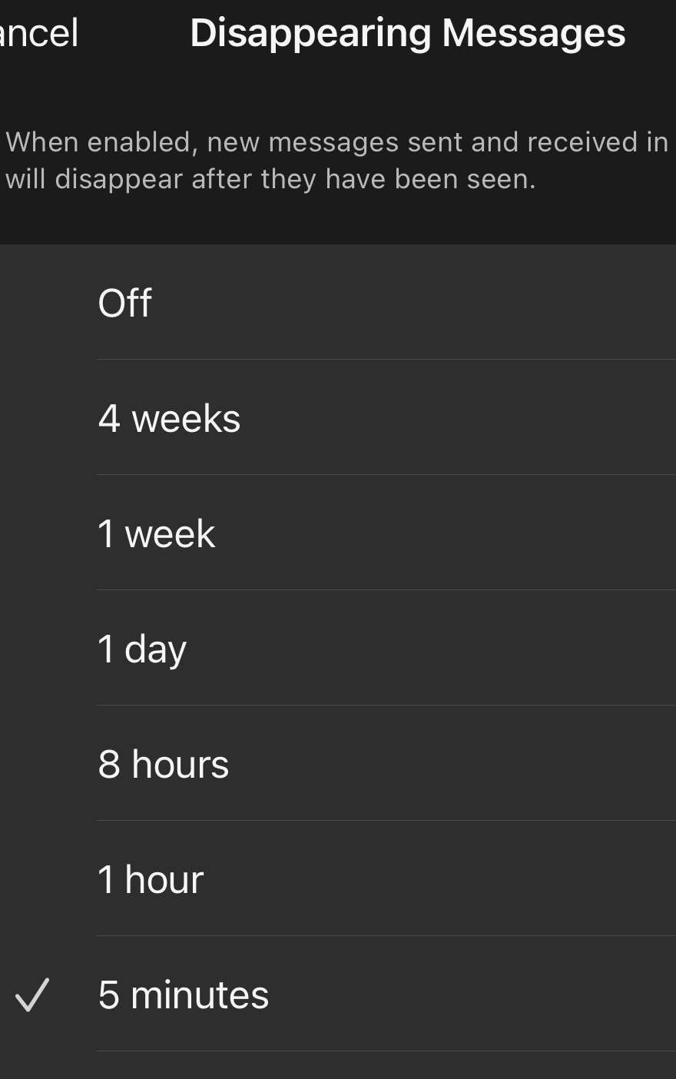
MITIGATING CONTROLS
Operate with a conscious understanding that digital privacy is nonexistent
Use comms with E2E encryption
Verify the recipient & set short message expiration times
Do not store or transmit anything private using systems you do not control

Slide 27
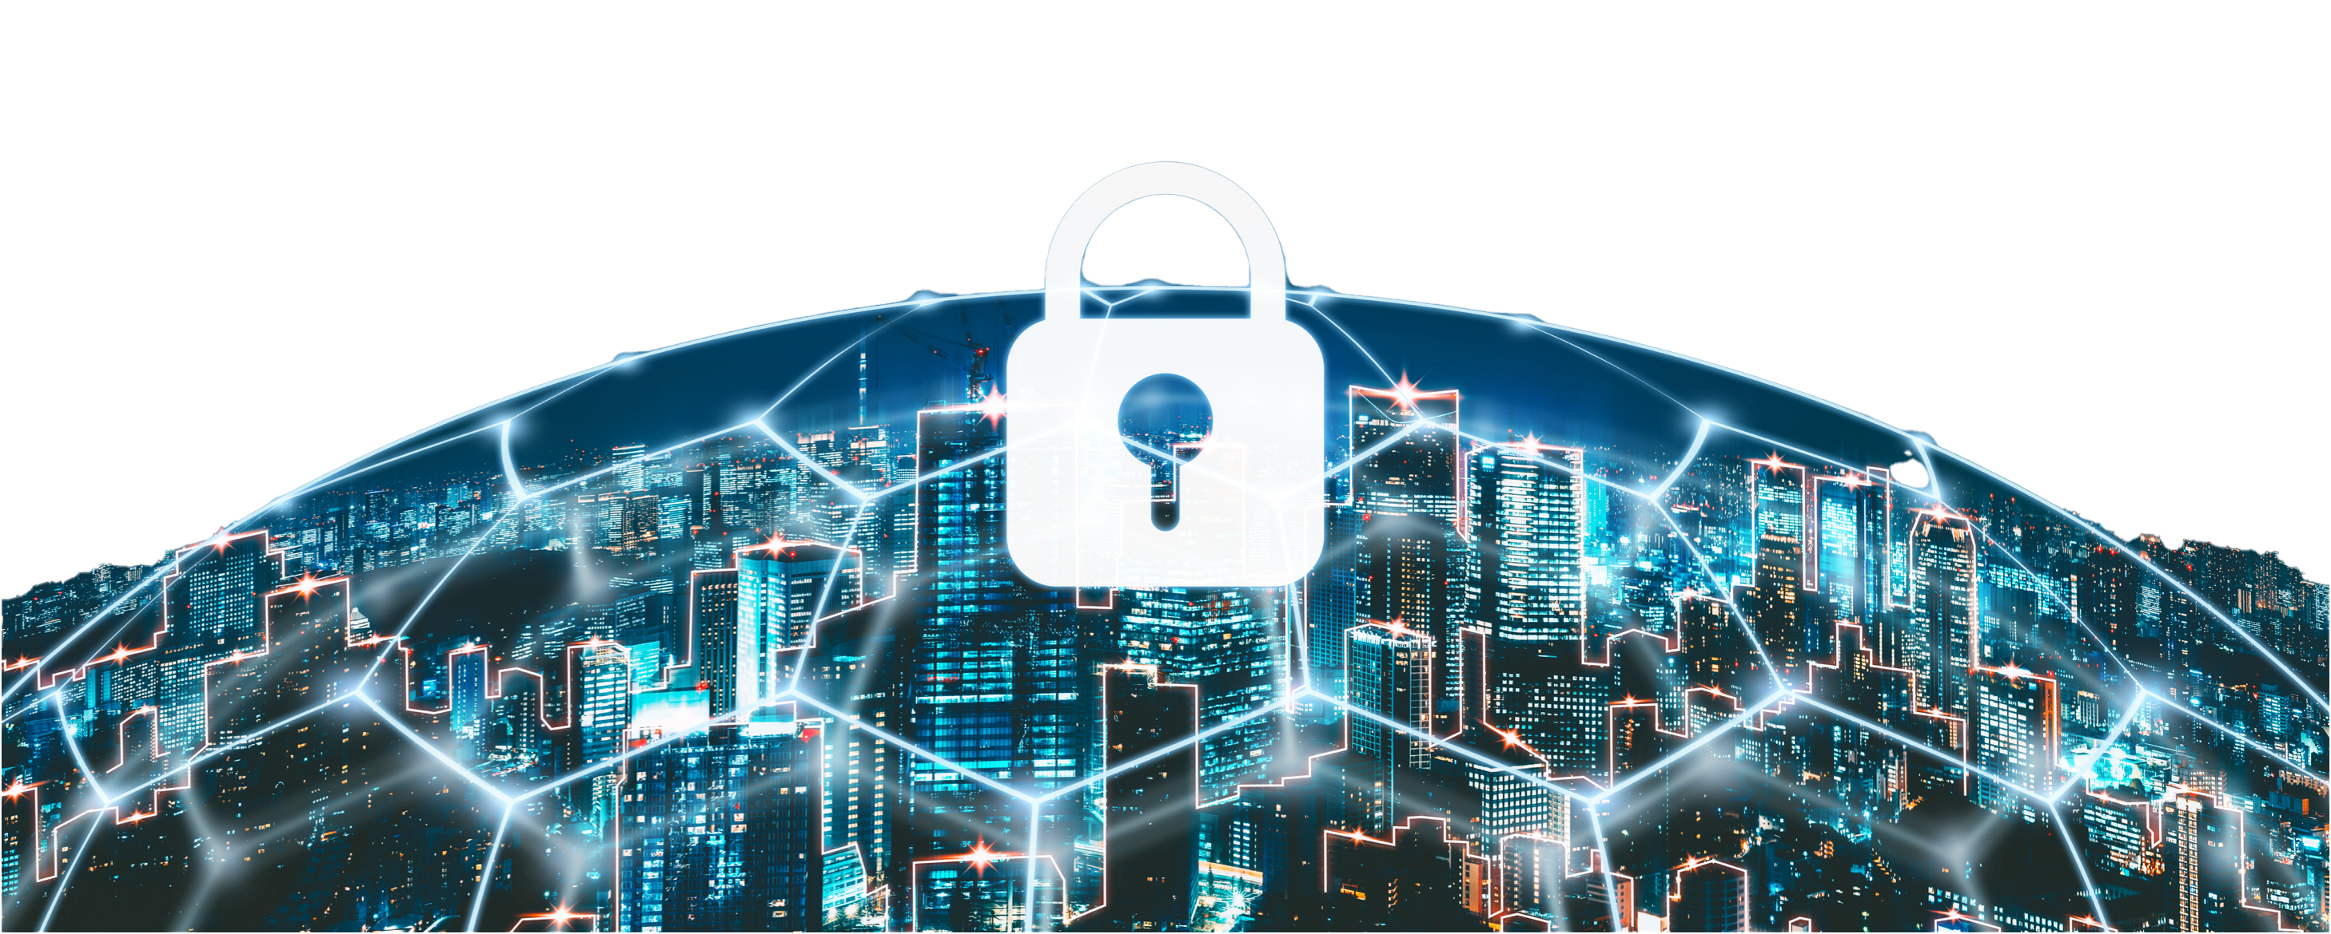
SAVING RYAN’S PRIVATES
Johnny Xmas, CISSP, GIAC
Technical Director of Training, GRIMM
https://grimm.rip

